Slide 1

Games with Uncertainty (pt 2)
Chris Kiekintveld

Slide 2
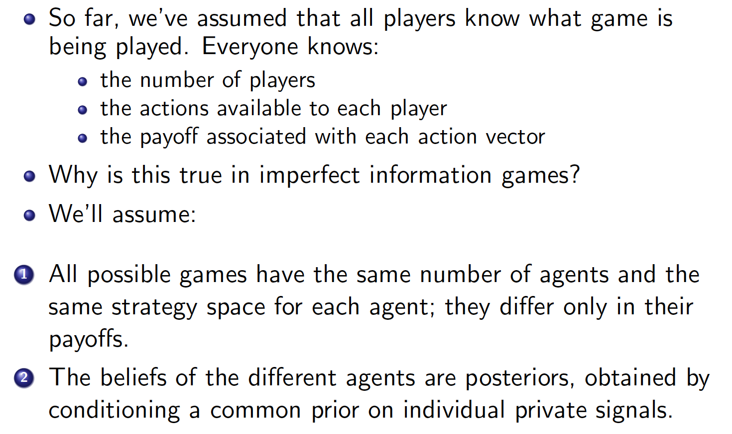
Bayesian Games

Slide 3
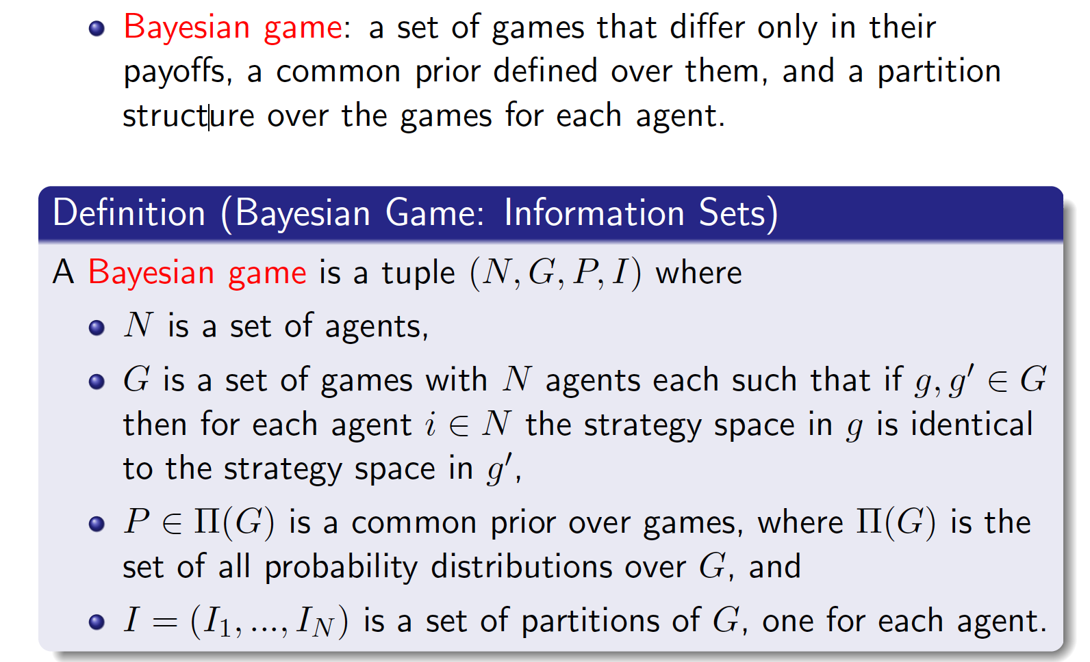
Information Sets

Slide 4
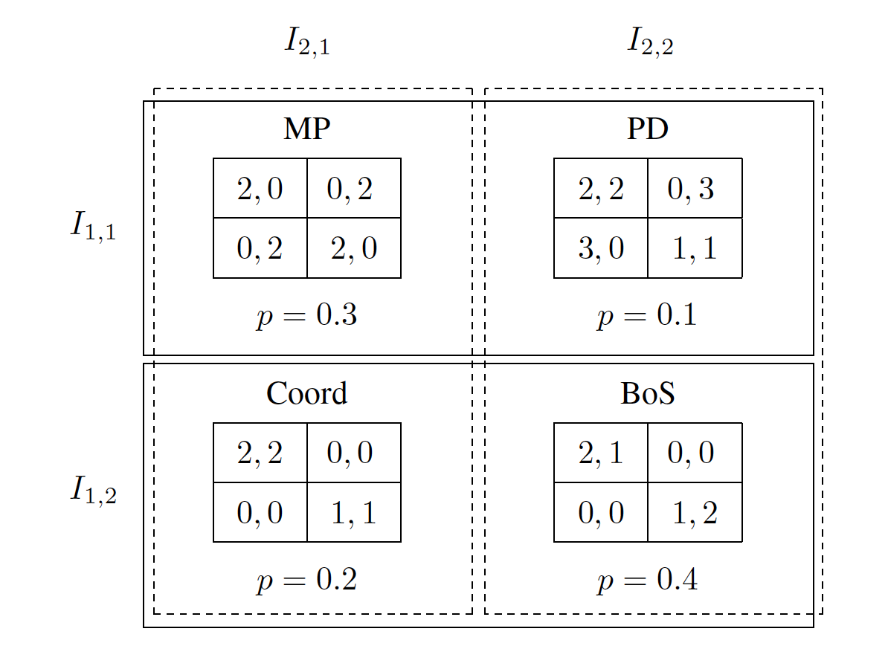
Information Sets Example

Slide 5
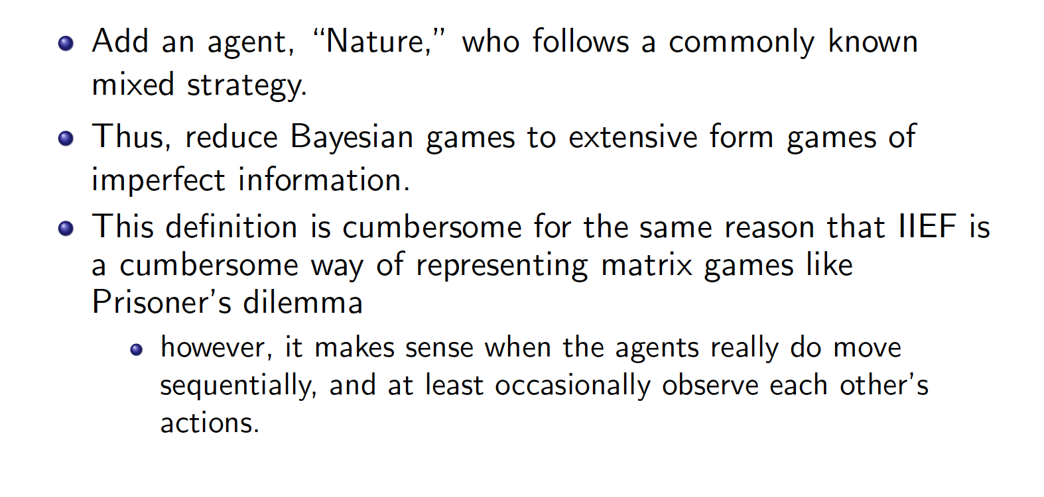
EFGs with Nature Player

Slide 6
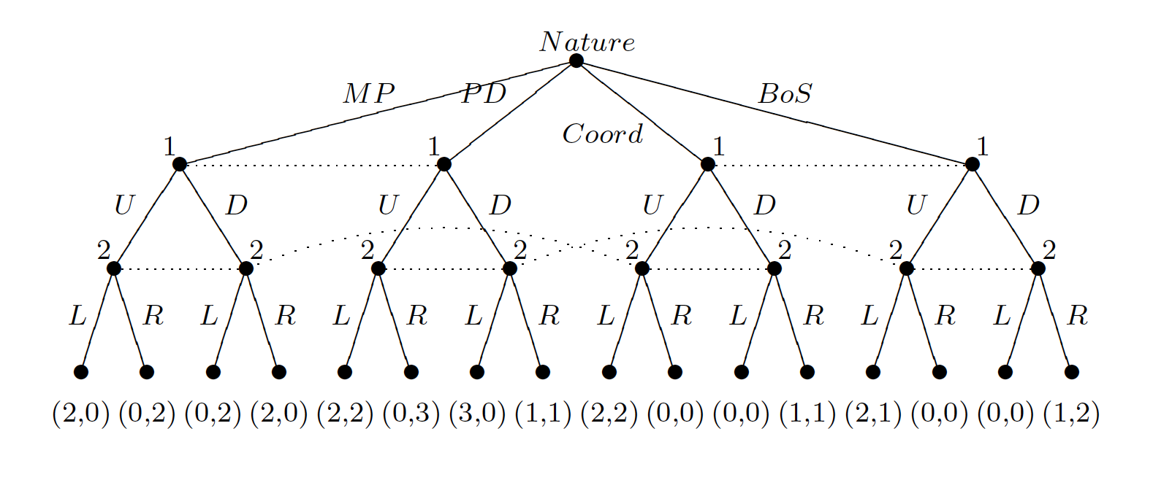
Example

